Slide 1
Prepare for the PSAT/NMSQT®: A Step to the Future

Slide 2
What is the PSAT/NMSQT?
Notes:
Let’s start with the basics. What is the PSAT/NMSQT?

Slide 3
What is the PSAT/NMSQT®?
Measures academic skills you’ll need for college
Co-sponsored by the College Board and National Merit Scholarship Corporation
Serves as an entry point to National Merit Scholarship Corporation competitions and practice for the SAT
Approximately 3.5 million students participate each year (44% eleventh-graders and 56% tenth-graders or younger)

Slide 4
Benefits of the PSAT/NMSQT®
Preparation for the SAT®
Scholarship and recognition opportunities (11th grade)
College and career planning tools
Admissions and financial aid information from colleges
Feedback on academic skills
Notes:
Preparation for the SAT: Same question types, format, and testing conditions as the SAT.
Scholarship and recognition opportunities: Entry point for National Merit Scholarship Corporation programs (usually in 11th grade) and other scholarship and recognition opportunities, including the National Hispanic Recognition Program.
Feedback on academic skills: Personalized feedback on critical reading, mathematics, and writing skills, including specific suggestions for improvement.
College and career planning tools: Free access to My College QuickStart™, an online tool that provides personalized information and interactive college and career planning resources.
Admissions and financial aid information: Students who say “Yes” to Student Search Service® when they take the test will be eligible to receive free information from colleges and scholarship services.

Slide 5
What Skills are Tested on the PSAT/NMSQT?
The test assesses the academic skills that you’ve developed over the years, primarily through your course work.
These skills are considered essential for success in high school and college:
Critical Reading
Mathematics
Writing Skills

Slide 6
Critical Reading Questions
Use content from:
humanities
social studies
natural sciences
literature
13 Sentence Completions
35 Passage-Based Reading Questions (100- to 800-word passages)
Notes:
There are two 25-minute critical reading sections that contain a total of 48 questions.

Slide 7
Mathematics Questions
Use content from:
-number and operations
-algebra and functions;
-geometry and measurement
-data analysis
-statistics
-probability
28 Multiple-Choice Questions
10 Student-Produced Response Questions (“Grid-ins”)
Notes:
There are two 25-minute mathematics sections that contain a total of 38 questions.

Slide 8
Writing Skills Questions
Focus on editing, grammar, usage, and organization.
20 Improving Sentences Questions
14 Identifying Sentence Error Questions
5 Improving Paragraph Questions
Notes:
There is one 30-minute writing section that contains a total of 39 questions.

Slide 9
How does the PSAT/NMSQT ® compare to the SAT®?
Question Types:
The same, except the PSAT/NMSQT does not have an essay component.
Length:
The PSAT/NMSQT is 2 hours, 10 minutes.
The SAT is 3 hours, 45 minutes.
Level of Difficulty:
The PSAT/NMSQT does not have 11th grade-level math questions.

Slide 10
Sample Questions
Notes:
Additional sample questions and test taking tips are available in the Official Student Guide to the PSAT/NMSQT.

Slide 11
Critical Reading: Sentence Completions
Roger said the report was significant; Heather contradicted him, saying that all the information presented was _______ .
(A) contemporary
(B) scintillating
(C) objective
(D) irrevocable
(E) immaterial
Notes:
SENTENCE COMPLETIONS measure knowledge of the meaning of words and ability to understand how the different parts of a sentence fit logically together.
Choice (A) is incorrect. To say that the information is contemporary, or current, is not to contradict its significance.
Choice (B) is incorrect. "Scintillating" means sparkling or brilliant. It is possible for a report to be both significant and scintillating, so Heather would not be contradicting Roger if she described the report in this way.
Choice (C) is incorrect. Heather would not be contradicting Roger if she said the report was objective, or unbiased. A report can easily be both significant and objective.
Choice (D) is incorrect. "Irrevocable" means unable to be taken back. This term is not the opposite of "significant" and therefore doesn't indicate a contradiction.
Because Heather is contradicting Roger, the correct response is the word that is most nearly the opposite of “significant.”
Choice (E) is correct.
“Immaterial” means inconsequential or irrelevant.
Information that is immaterial is by definition not significant.

Slide 12
Math Section: Student-Produced Response
Know the Student-Produced Response Directions! The correct answer must be gridded correctly to receive credit. What is written in the boxes is not scored.
h
4
1
3
5h
6
If
+
=
, then what is the value of h?
4
/
7
Multiply each member of the equation by 12 (the common denominator) to get 3h + 4 = 10h
Subtract 3h from both sides to get 7h = 4
Divide by 7
h = 4/7
Notes:
STUDENT-PRODUCED RESPONSE questions do not have answer choices. Answers are recorded on this grid.
To put the answer (4/7) on the grid, first write 4, then the fraction bar (slash), and then 7 in the spaces above the grid. It does not matter whether you start at the first space at the left or finish in the last space at the right. If the answer were 2, we could put the 2 in any one of the four answer spaces and bubble in the 2 below it. THE ANSWER MUST BE BUBBLED on the grid in order to receive credit. Incorrect gridding of the answer (ending up different from the one written in the spaces) is one of the most common errors and a sure way to lose points.
Note to Presenter: The directions for recording answers to STUDENT-PRODUCED RESPONSE questions are written in the test booklet and in the Official Student Guide to the PSAT/NMSQT. Students should read the directions before test day.

Slide 13
Test Preparation Strategies

Slide 14
Know How the PSAT/NMSQT Is Scored
Multiple-choice questions:
1 point for each correct
¼ point deducted for each incorrect
Math grid-ins:
1 point for each correct
0 points for each incorrect
0 points for omitted questions

Slide 15
Personalized Skills Information
The PSAT/NMSQT Score Report:
contains information to help you improve your academic skills.
lists skills that you have the best chance of improving with additional work.
includes advice, written by teachers, on how to improve those skills.

Slide 16
Test Preparation: Long-Term
READ!
Continuous reading improves vocabulary and develops essential skills.
Read more books than just those required for class.
Take Challenging Courses!
This will help you to develop and strengthen your critical thinking skills.

Slide 17
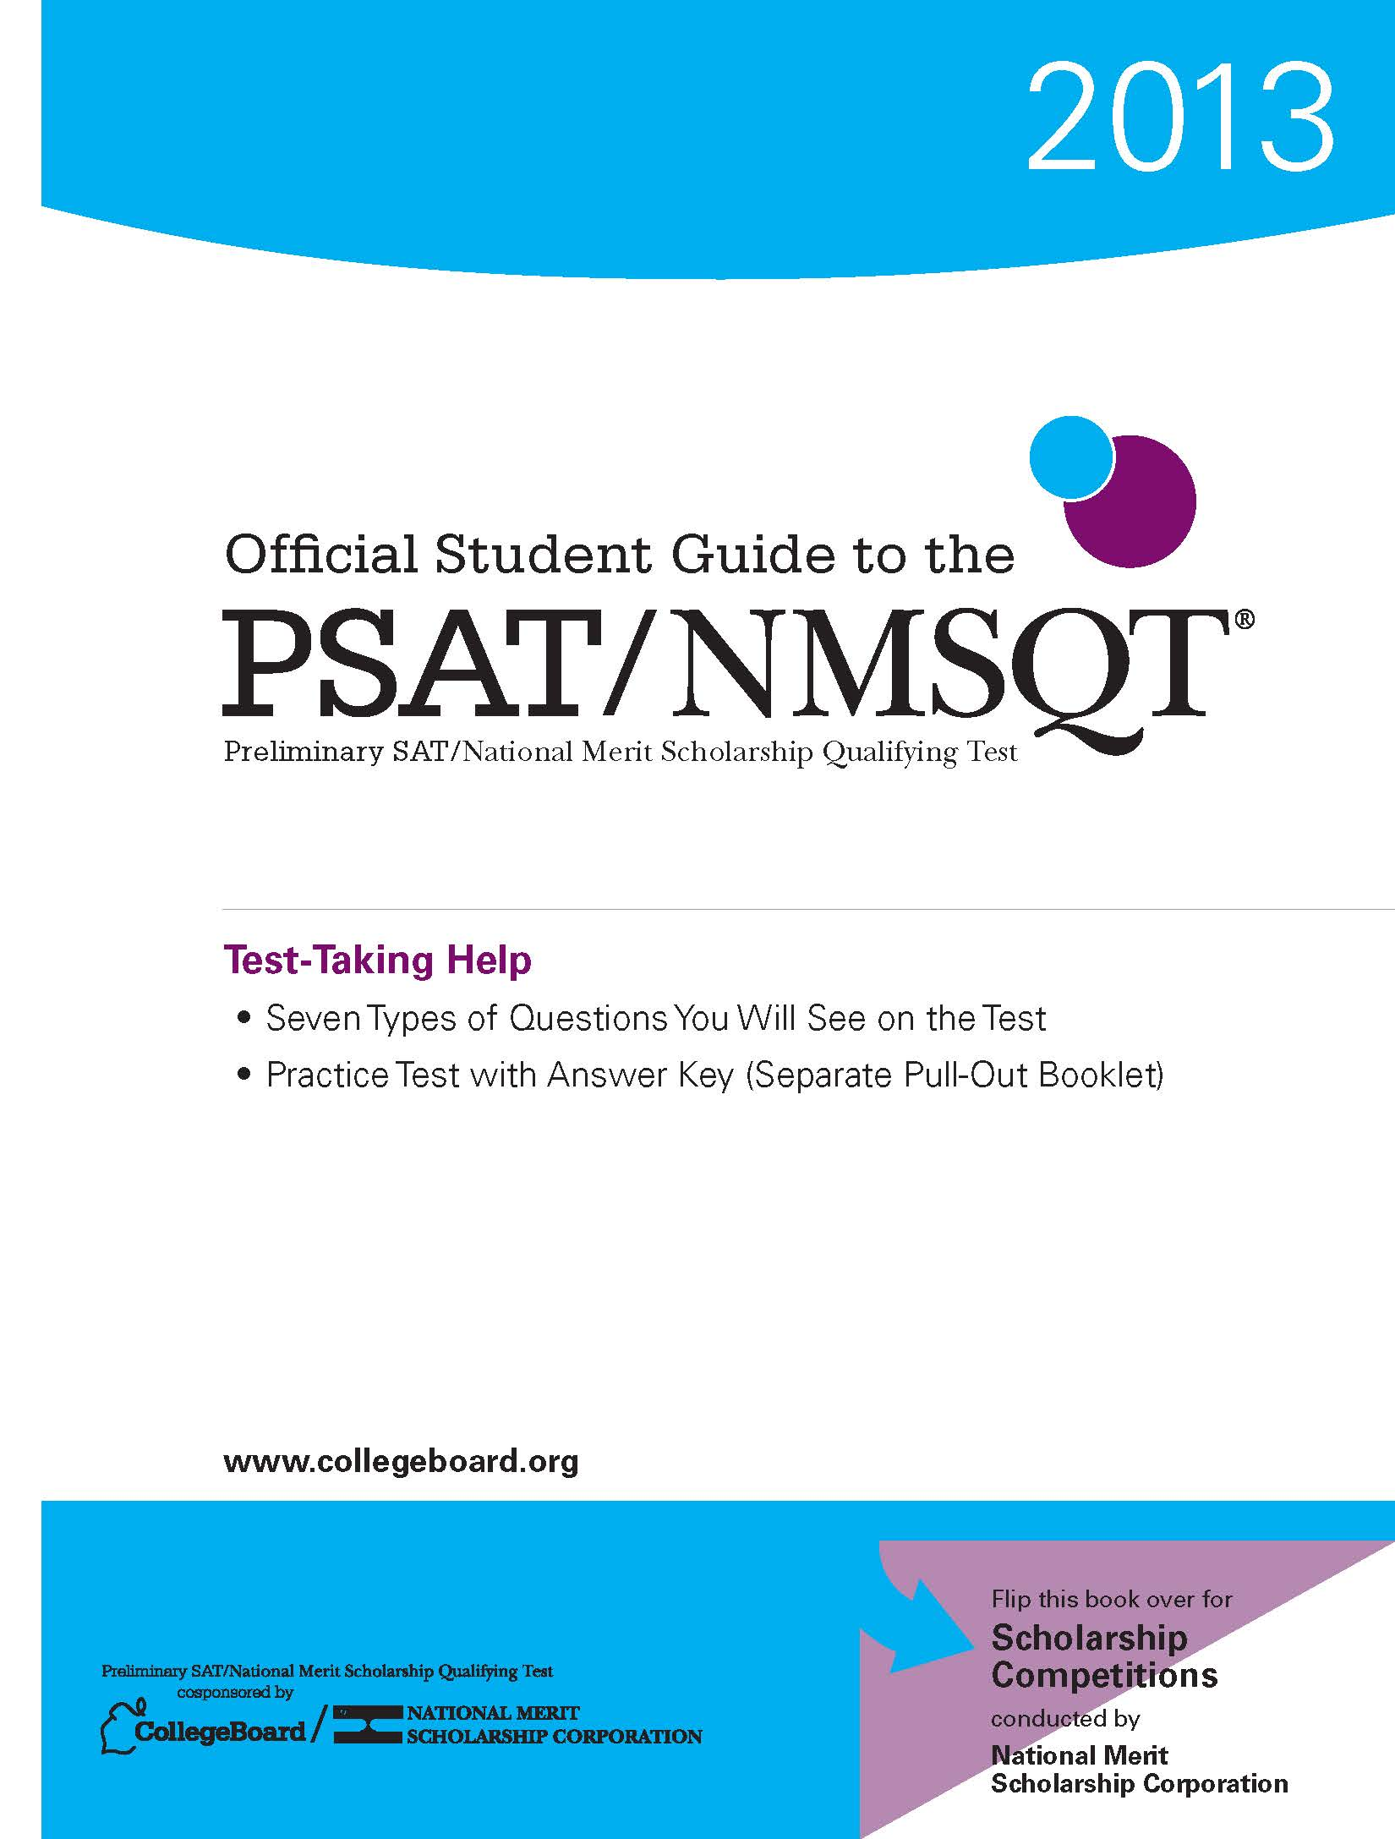
Test Preparation: Short-Term
Take the practice test in the Official Student Guide to the PSAT/NMSQT.
Understand scoring and “educated guessing.”
Familiarize yourself with the test’s format, questions types, and directions.

Slide 18
Test Preparation: Test Readiness Strategies
When you sit down to take the test:
Read all of the directions.
Read all of each question’s answer choices.
Do scratch work in the test book.
Work at a steady pace.
If you skip a question:
Note it in the test book.
Leave it blank on the answer sheet.
Return to it if there is time.
Remember: you don’t have to answer every question to score well.
Notes:
Note to Presenter: Students can make an educated guess by eliminating one or more wrong choices; they increase their chances of choosing the correct answer and earning one point. However, students should avoid wild or random guessing.

Slide 19
Visit collegeboard.org

Slide 20
Take the PSAT/NMSQT
How to Sign Up: All 10th graders will test
Test Day/Date: Wednesday, October 29, 2014
Time: 7:55 – 11 AM
Location: DES Cafeteria, students will walk over together
Bring:
Two #2 Pencils
Calculator (optional)
Notes:
Note to Presenter: Use this slide to inform your students about the PSAT/NMSQT test day by editing the slide in Microsoft PowerPoint. Provide the important facts, such as day, date, and location of testing, as well as a reminder to bring a calculator (optional) and #2 pencils. Remember, Social Security numbers and email addresses are optional. You may also want to include information about the cost of the test; where and when they register (with a deadline date); and anything else that you think they’ll need to know.

Slide 21
PSAT/NMSQT
A Step to the Future

