Slide 1
Sexuality Education
Bethany Sinkhorn
CPSY 644

Slide 2
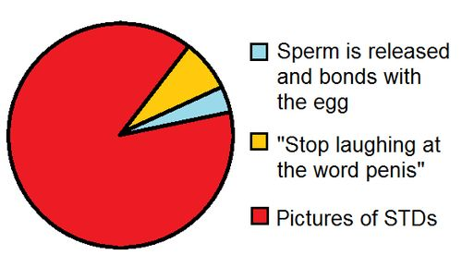
Pinterest.com

Slide 3
“Sex education is just about puberty and its embarrassing” – Student, age 9
“Sex education is about anatomy and its embarrassing when your teacher who you see everyday, is saying it to you, it should be some high-schoolers” – Student, age 13
“Sex ed. is teaching kids not to have sex, especially at a young age” – Student, age 15
“Sex ed. is lectures about not having sex, so you don’t get a disease and die. Also so you don’t get pregnant” – Student, age 17

Slide 4
What did your puberty talk and/or Sex Ed. look like?
What was your school counselor’s involvement?
What would you have liked to been included in your ‘talk’?

Slide 5
How do LGBTQ students fit into the curriculum? How can school counselors advocate for them across the system?

Slide 6
How can we, as future school counselors, advocate for a more inclusive sex ed. curriculum at several different levels (i.e. School building, school board, state, etc.)?
How would you speak with a parent and their pregnant student about the choices they have and what can you do at the school to advocate for the student?
You have a female elementary student who often tells you about her boyfriend. How would you gather more information about that relationship and address any possible concerns with the student?

